Slide 1
Introduction To computer Vision
Draw a chart

Slide 2
Presentation Assignment
Prepared By : Mohsen Saadan Mohamed.
4Th year - IT Dep. Section(2).
Under Supervision :Dr: Khaled F.Hussien.

Slide 3
Pie Charts
Pie charts display the percentage that each element in a vector or matrix contributes to the sum of all elements.
Pie and pie3 create 2-D and 3-D pie charts.

Slide 4
Syntax
Pie(X)
Pie(X,explode)
Pie(...,labels)

Slide 5
Pie(X)
Draws a pie chart using the data in X. Each element in X is represented as a slice in the pie chart.
x=[.19 .22 .41 .18];
Pie(x);

Slide 6
Pie(X,explode)
A slice from the pie. explode is a vector or matrix of zeros and nonzero that correspond to X.
Create a vector containing zeros.
explode = zeros(size(x)).
Then find the slice that contributes the most and set the corresponding explode element to 1.
[c,offset] = max(x);
explode(offset) = 1;
h = pie(x, explode);

Slide 7
Pie(...,labels)
Specifies text labels for the slices.
The number of labels must equal the number of elements in X.
For example:- Pie(1:3,{'Taxes','Expenses','Profit'}).

Slide 8
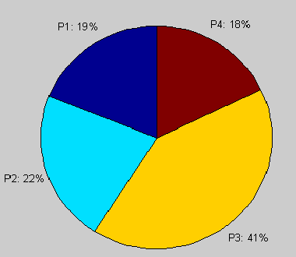
2-D (Pie) Chart

Slide 9
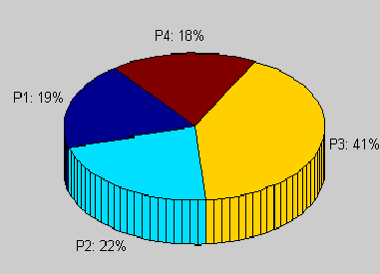
3-D (Pie3 ) Chart

Slide 10
Explode
A slice from the pie.
Explode is a vector or matrix of zeros and nonzero that correspond to X.
A nonzero value offsets the corresponding slice from the center of the pie chart.
Explode must be the same size as X.

Slide 11
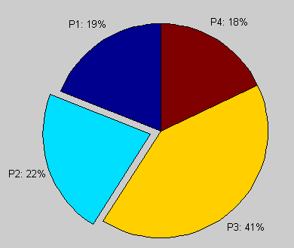
Exploded (Pie) chart

Slide 12
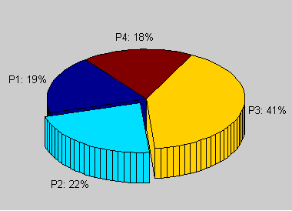
Exploded (Pie3) chart

Slide 13
Findobj
Locate graphics objects with specific properties
Findobj('PropertyName',PropertyValue,...) returns the handles of all graphics objects having the property PropertyName, set to the value PropertyValue.

Slide 14
(Get) Object properties
v = get(object) returns a structure of the properties of object and the corresponding property values, assigning the structure to v.
v = get (object, 'property') retrieves the value of property for object, assigning the value to v.

Slide 15
(Set) object properties
Set(H,'PropertyName',PropertyValue,...) sets the named properties to the specified values on the object(s) identified by H. H can be a vector of handles, in which case set sets the properties' values for all the objects.

Slide 16
Strcat
Concatenate strings horizontally.
t = strcat(s1, s2, s3, ...).
Horizontally concatenates corresponding rows of the character arrays s1, s2, s3, etc. All input arrays must be a single string. When the inputs are all character arrays, the output is also a character array.

Slide 17
Labeling the Graph
The pie chart's labels are text graphics objects. To modify the text strings and their positions, first get the objects' strings and extents. Braces around a property name ensure that get outputs a cell array, which is important when working with multiple objects.
textObjs = findobj(h,'Type','text');
oldStr = get(textObjs,{'String'});

Slide 18
Cont ….
Create the new strings, then set the text objects' String properties to the new strings.
Names = {'Product X: ';'Product Y: ';'Product Z: '};
newStr = strcat(Names,oldStr);
set(textObjs,{'String'},newStr)

Slide 19
Remarks
The values in X are normalized via X / (sum) to determine the area of each slice of the pie. If (sum)<=1, the values in X directly specify the area of the pie slices. MATLAB draws only a partial pie if (sum)<1.

Slide 20
Reference
MATLAB Help.

